Slide 2
PROFIT AND LOSS
DISCOUNT
BY
VARAPRASAD POLAVARAPU

Slide 3
BASIC TERMINOLOGY IN PROFIT AND LOSS

Slide 4
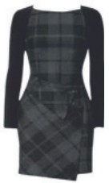
1. Assume that you are going to a shop to buy a dress. You find the dress on the mannequin very attractive and wish to buy it. The tag price of the
dress is Rs. 5400. You buy that dress at a special discount of 20%. When you show that dress to your friend, he reveals that he was the one who
designed that dress and had sold it to the shop for Rs. 1080.
From the shop owners point of view,
i)
How is the amount Rs. 1080 called? __________
ii)
How is the amount Rs. 5400 called? __________
iii)
What is the discount given?
iv)
What is the profit/loss incurred by the shopkeeper? __________
v)
What is the profit/loss %? __________

Slide 5
2. A man buys a cycle for₹ 1400 and sells it at a loss of 15%. What is the selling price of the cycle?
a)1202 b)1190 c)1160 d) ₹1000

Slide 6
3. On selling an article for₹651. there is a loss of 7%. The cost price of that article is
a) 744 b)751 c)793 d) ₹700

Slide 7
4.A man buys 12 articles for ₹12 and sells them at the rate of ₹1.25 per article. His gain percentage is?
a) 20% b) 25% c)15% d) 18%

Slide 8
5. Ram sells 2 flats for Rs. 198 lakhs each. On one transaction he loses 10% and on the other he gains 10%. What is his net profit or loss percentage?
No profit or Loss
1% loss
1% gain
No of these above

Slide 9
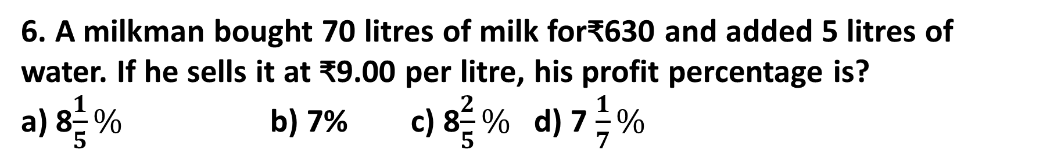
6. A milkman bought 70 litres of milk for₹630 and added 5 litres of water. If he sells it at ₹9.00 per litre, his profit percentage is?
a) 8$\frac{1}{5}\%$ b) 7% c) 8$\frac{2}{5}\%$ d) 7 $\frac{1}{7}\%$

Slide 10
7-A : The ratio of cost price and selling price is 5: 4, the loss percent is?
a) 20% b) 25% c) 40% d) 50%
7-B : The ratio of cost price and selling price is 20: 21, the gain percent is?
a) 20% b) 5% c) 25% d) 10%

Slide 11
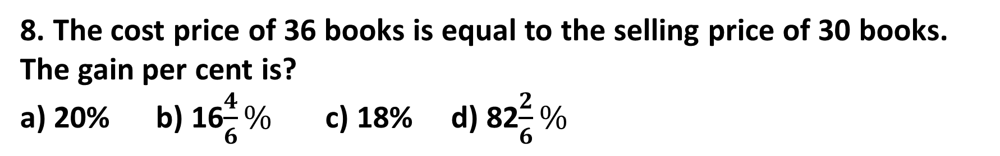
8. The cost price of 36 books is equal to the selling price of 30 books. The gain per cent is?
a) 20% b) 16$\frac{4}{6}\%$ c) 18% d) 82$\frac{2}{6}\%$

Slide 12
9. The selling price of 5 articles is the same as the cost price of 3 articles. The gain or loss percent is?
a) 20% gain b) 25% gain c)33.33% loss d)40%loss

Slide 13
10. Successive discounts of 10% and 30% are equivalent to a single discount of ?
a)40% b) 35% c) 38% d) 37%

Slide 14
11. The marked price of a watch was 720/-. A man bought the same for 550.80, after getting two successive discounts, the first at 10%. What was the second discount rate?
a) 12% b) 15% c) 14% d) 18%

Slide 15
12. A tradesman marks his goods 10% above his cost price. If he allows his customers 10% discount on the marked price, how much profit or loss does he make, if any?
a) 1% gain b) 1%loss c) 5% gain d) No gain, no loss

Slide 16
13. A dealer offers a discount of 10% on the marked price of an article and still makes a profit of 20%. If its marked price is₹800, then the cost price of the article is ?
a) ₹900 b)₹800 c) ₹700 d)₹600

Slide 17
14. A trade man marks his goods at 20% above the cost price. He allows his customers a discount of 8% on marked price. Find out his profit per cent.
a) 12% b) 10.4% c) 8.6% d) 8.2%

Slide 18
15. A dishonest shopkeeper professes to sell his goods at cost price, but he
gives only 800 g instead of 1000 g. What is his profit %?

Slide 19
16.Oranges are bought at rate of 7 for ₹3. At what rate per hundred must they be sold to gain 33%?
a) ₹56 b) ₹60 c) ₹58 d) ₹57

Slide 20
17. A vendor bought lemons at 6 for ₹1. How many lemons must he sell for ₹1 to gain 100% ?
a) 7 b) 4 c) 5 d) 3

Slide 21
18. A vendor bought lemons at 7 for ₹1. How many lemons must he sell for ₹1 to gain 40% ?
a) 6 b) 9 c) 5 d) 7

Slide 22
19. The marked price of an article is 200. A discount of 12.5% is allowed on the marked price and a profit of 25% is made. The cost price of the article is :
a) 200 b)175 c) ₹120 d)140

Slide 23
PARTNERSHIP
The capital investment ration

Slide 24
1. A and B together invested Rs. 18000 in a business. The ratio of their investments was 4 : 5. At the end of the year, a total profit of Rs. 2700 was generated. Find their profits?
a) 1200, 1500 b) 1300, 1400 c) 1400, 1300 d) none

Slide 25
2. Dhivya and Ramya started a business. They both invested Rs. 100,000 each. At the end of 6 months, Ramya predicts that the business will end up in a loss and she withdrew Rs. 60,000 from the business. But, at the end of one year, the business generated a profit of Rs. 34,000. What will be the profit share of each person?

Slide 26
3. Monish started a business by investing Rs. 80000. Six months later, Mani joined him with a capital of Rs. 140000. If at the end of the year, the total profit is Rs. 37500, then what is Mani’s share of profit?
a) 25000 b) 17500 c) 15000 d) None

Slide 27
4. Anand and Babu invest in a business in the ratio 4 : 3. If 2% of the total
profit goes to charity and Anand’s share is Rs. 854, what is Babu’s share?

Slide 28
21. An item costing₹840 was sold by a shopkeeper at a gain of 10% and it was again sold by the new buyer at a loss of 5%. Final selling price of the item is :
a)877.80 b) 798 c)924 d)37.80

Slide 29
22. A shopkeeper gains 20% while buying the goods and 30% while selling them. Find his total gain percent
a) 10% b) 56% c) 40 % d)50%

Slide 30
23. By selling an article for ₹240. Man incurs a loss 10% . At what price should he sell it, so that he makes a profit of 20% ?
a) 230 /- b) 320/- c) 60/- d) 250/-

Slide 31
24. A radio is sold for₹990 at a profit of 10%. What would have been the actual profit or loss on it, had it been sold for Rs. 890 ?
a)₹10 loss b)₹10 profit c) ₹90 loss d)90 profit

Slide 32
25. Two articles are sold at Rs. 199 each such that a profit of 10% is made on the first while a loss of 10% is incurred on the other. What would be the net profit/loss on the two transactions?
a) loss of 1% b) gain of 1% c) No loss or gain d) None

